Slide 1
DESIGN & ANALYSIS OF ALGORITHM
PCC-CS404

Slide 2
How to write an algorithm
GCD PROBLEM
Algorithm: GCD(M,N)
Objective: Following algorithm returns/calculates the greatest common divisor of two number M,N where N>M.
{
while(N % M !=0)
R := N%M // R ← N%M
N := M
M := R
end while
Return N
}

Slide 3
properties of algorithm
Input
Output
Finiteness
Definiteness
Efficiency

Slide 4
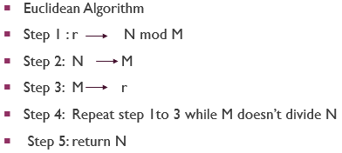
properties of algorithm gcd(M,n)
Input------ ---- M,N numerical type
Output---- ---- gcd of M,N numerical type
Finiteness-- ---- for 36,48 it is 3
Definiteness-- ---- steps are definite
Efficiency -------------------------------------O(Log min(a, b))

Slide 5
Best / worst case / average
Input Instance scenario.
Best Case: In which we analyse the performance of an algorithm for the input, for which the algorithm takes less time or space.
Worst Case: In which we analyse the performance of an algorithm for the input, for which the algorithm takes long time or space.
Average Case: In which we analyse the performance of an algorithm for the input, for which the algorithm takes time or space that lies between best and worst case.

Slide 6
Best / worst / average case linear search
10 | 15 | 8 | 7 | 5 | 8
Best Case: search 10.
Worst Case: search 9.
Average Case: search 15 or search 5

Slide 7
Best / worst / average case binary search
Best Case: search 5. O(1)
Worst Case: search 15 or search 5 or search 20. O(logn)
Average Case: search 6, search 12 O(logn)
0 1 2 3 4 5 6 7
5 | 6 | 7 | 9 | 10 | 12 | 14 | 15

Slide 8
Type of Algorithm Analysis -
TIME
SPACE

Slide 9
FREQUENCY COUNT METHOD Analysis of algorithm
Algorithm sum(a,b)
{
1 sum ← a+b ………………….……1 // 2
2 Return sum …………………….1
} ----
2 T_{sum}(a,b)=2 O(1)
S_{sum}(a,b)=3 O(1)

Slide 10
FREQUENCY COUNT METHOD Analysis of algorithm
Algorithm sum(A,n)
{ 1 sum ← 0……………………………………….1
2 while( i : 1 to n) n+1
3 sum ← sum + A[i] ………………….…1.n // 3.n
end while
4 Return sum ………………………………….1
} ----
2n+3 T_{sum}(a,b)=2n+3 O(n)
S_{sum}(a,b)=n+1+1+1 O(n)

Slide 11
FREQUENCY COUNT METHOD Analysis of algorithm
Algorithm : SUM(A,B,n)
{
1 for( i :=0, i<n, i++) n+1
2 for(j: 1 to n) n *(n+1)
3 C[i][j]← A[i][j] + B[i][j] n * n
end while
4 Return sum 1
} ------------
2n²+2n+2 T_{sum}(A,B,n) = 2n²+2n+2 O(n²)
S_{sum}(a,b) = 3n²+1+1+1 O(n²)

Slide 12
FREQUENCY COUNT METHOD Analysis of algorithm
Algorithm : MULTIPLICATION(A,B,n)
{
1 for( i :=0, i<n, i++)………………………………………………n+1
2 for(j: 1 to n)…………………………………………………
3 C[i][j] ← 0…………………………………………………
4 for(k: 1 to n)………………………………...........
5 C[i][j]← C[i][j] + A[i][k] * B[k][j]………..
end while
6 Return sum…………………………………………………….....1
}

Slide 13
FREQUENCY COUNT METHOD Analysis of algorithm
considering ith loop at step no 1
Algorithm : MULTIPLICATION(A,B,n)
{
1 for( i :=0, i<n, i++)………………………………………………n+1
2 for(j: 1 to n)…………………………………………………n
3 C[i][j] ← 0…………………………………………………n
4 for(k: 1 to n)………………………………........... n
5 C[i][j]← C[i][j] + A[i][k] * B[k][j]………..n
end while
6 Return sum…………………………………………………….....1
}

Slide 14
FREQUENCY COUNT METHOD Analysis of algorithm
considering jth loop at step no 2
Algorithm : MULTIPLICATION(A,B,n)
{
1 for( i :=0, i<n, i++)………………………………………………n+1
2 for(j: 1 to n)…………………………………………………n*(n+1)
3 C[i][j] ← 0…………………………………………………n*n
4 for(k: 1 to n)………………………………........... n*n
5 C[i][j]← C[i][j] + A[i][k] * B[k][j]………..n*n
end while
6 Return sum…………………………………………………….....1
}

Slide 15
FREQUENCY COUNT METHOD Analysis of algorithm
considering kth loop at step no 4
Algorithm : MULTIPLICATION(A,B,n)
{
1 for( i :=0, i<n, i++)………………………………………………n+1
2 for(j: 1 to n)…………………………………………………n*(n+1) T_{mul}(N)= 2n³+3n²+2n+2
3 C[i][j] ← 0…………………………………………………n*n O(n³)
4 for(k: 1 to n)………………………………........... n*n*(n+1)
5 C[i][j]← C[i][j] + A[i][k] * B[k][j]………..n*n*n
end while
6 Return sum…………………………………………………….....1
}

Slide 16
FREQUENCY COUNT METHOD Q Analysis of algorithm
for(i=1;i<n;i=i*2) {statement} - its Time complexity is
Answer : O(log n)
Explanation: 1 2 2² 2³ 2⁴ ………2^{k} [k indicates number of steps]
2^{k} = n
K log2 = log n [considering log both side]
K= log n ………………………………………. T(n)=O(k) O(logn)

Slide 17
FREQUENCY COUNT METHOD Analysis of algorithm
1 for( i :=0, i<n, i++) Time complexity of the code snippet ?
2 for(j=0,j<i, j++)
3 statement
Answer :
0 0 0
1 0,1 1
2 0,1,2 2
n 0 to n n
so T(n)=0+1+2+3+……+n=n(n+1)/2 O(n²)
i | j | No of step

Slide 18
FREQUENCY COUNT METHOD Analysis of algorithm
1 x=0 Time complexity of the code snippet ?
2 for( i :=1, x<=n, i++)
3 x= x + i
Answer : I x
1 1
2 1+2
2 1+2+3
k 1+2+3……k so T(n)=k*(k+1)/2 >n so k > O(√n)

Slide 19
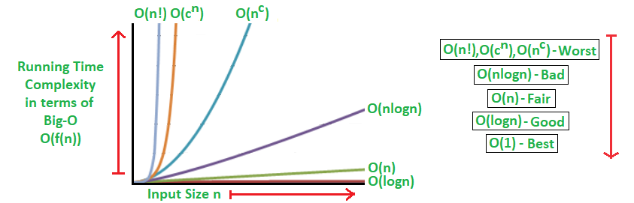
order of Complexities
1 < logn < √n < n < nlogn <n² <n³< ………………..<2^{n}<3^{n}< n^{n}

Slide 20
Common approach
1.For(i=0 , i<n , i++) O(n)
2.For(i=0 , i<n , i=i+2) O(n)
3.For(i=10 , i>1 , i--) O(n)
4.For(i=0 , i<n , i=i*2) O(log₂n)
5.For(i=0 , i<n , i=i*3) O(log₃n)
6.For(i=0 , i<n , i=i/2) O(logn)

Slide 21
Different input scenario
If(x==0) x=0 O(1) x!=0 O(logn)
printf (“Start Execution.”);
else
for(i=1;i<n;i=i*2) {statement}

Slide 22
Next class topic-
Frequency Counting Method Continue

